Slide 1
Data Harmonization and Insights extraction
by Windows User

Slide 2
OBJECTIVE
The goal is to leverage advanced data-wrangling techniques to produce a clean, unified dataset for future business analysis and modeling

Slide 3
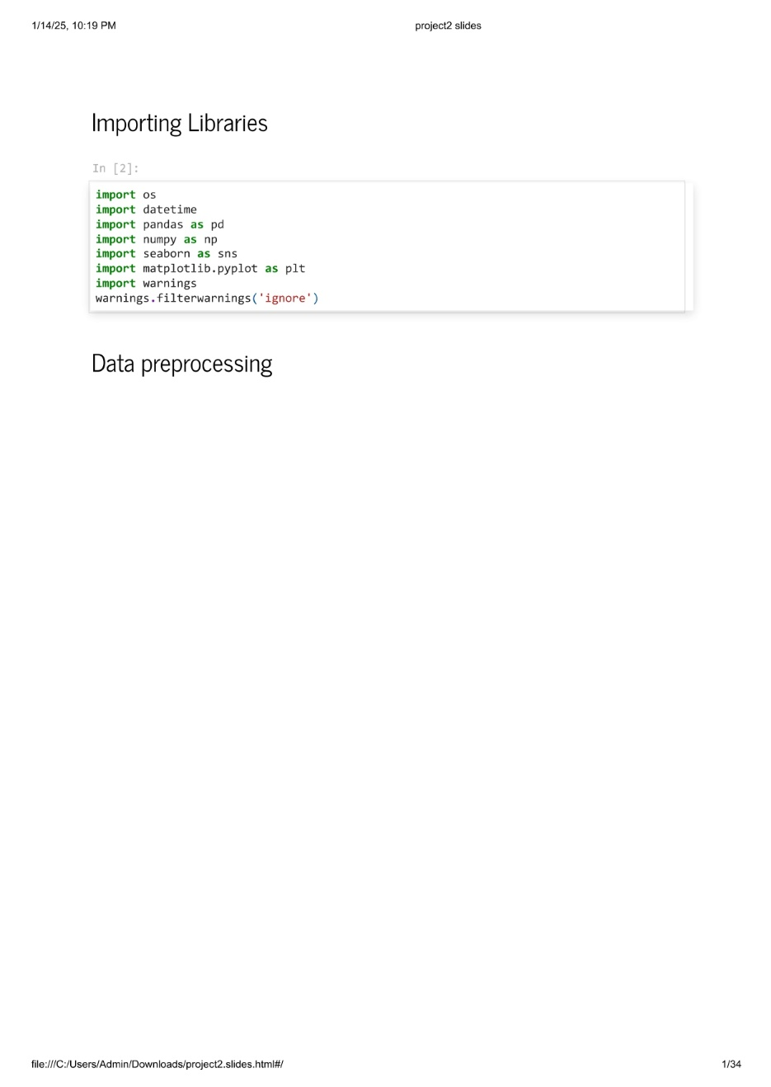
Data Harmonization
Libraries Used for Visualising the data provided

Slide 4
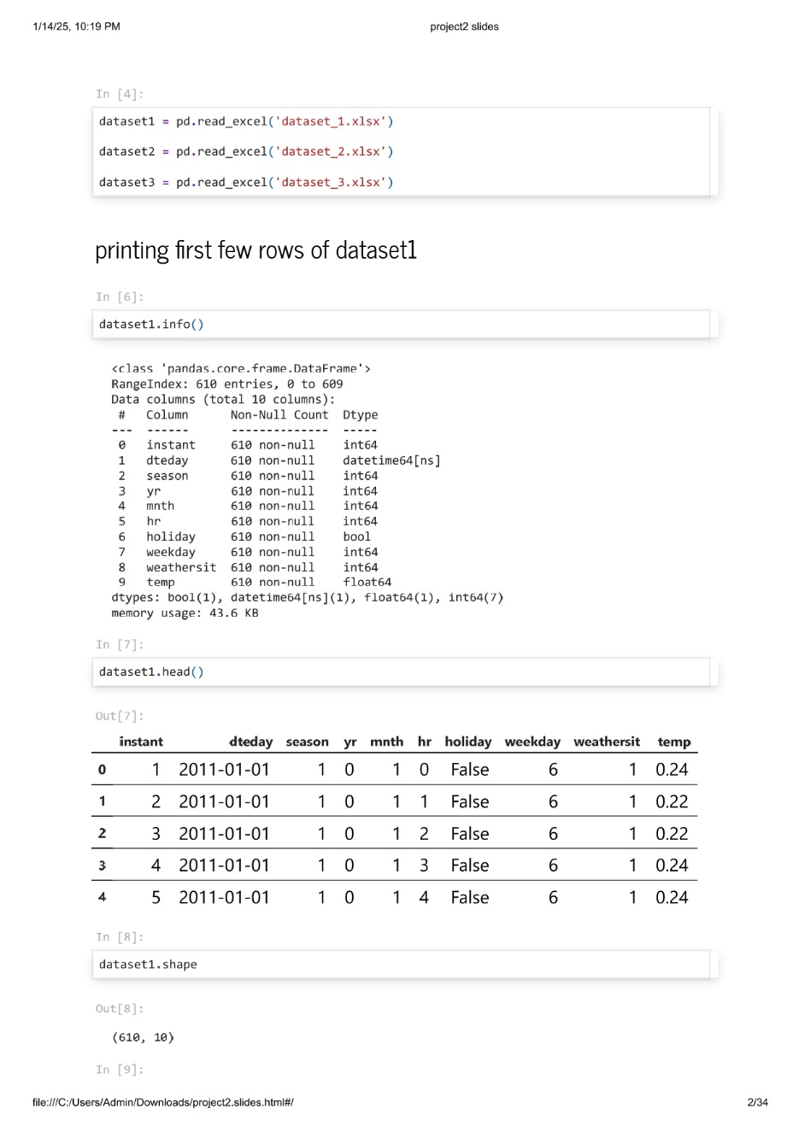
DATA PRE-PROCESSING
PRINTING FIRST FEW ROWS OF DATASET1
1. Dataset1.info()
2. Dataset1.head()
3. Dataset1.shape
4. Dataset1.describe()
5. Dataset1.isnull().sum()
6. Dataset1.duplicated()

Slide 5
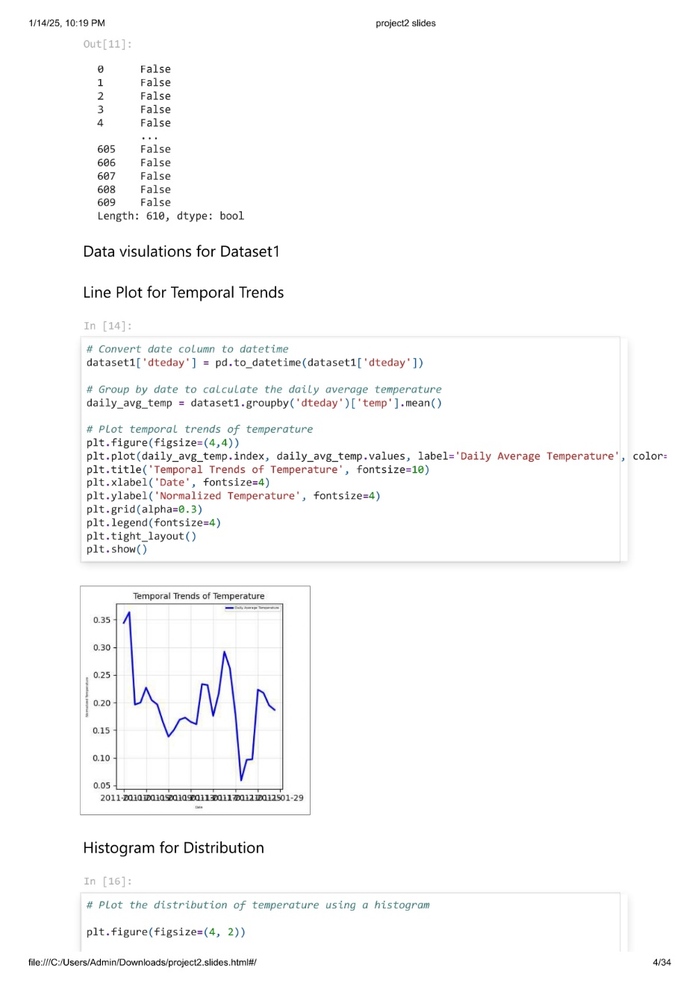
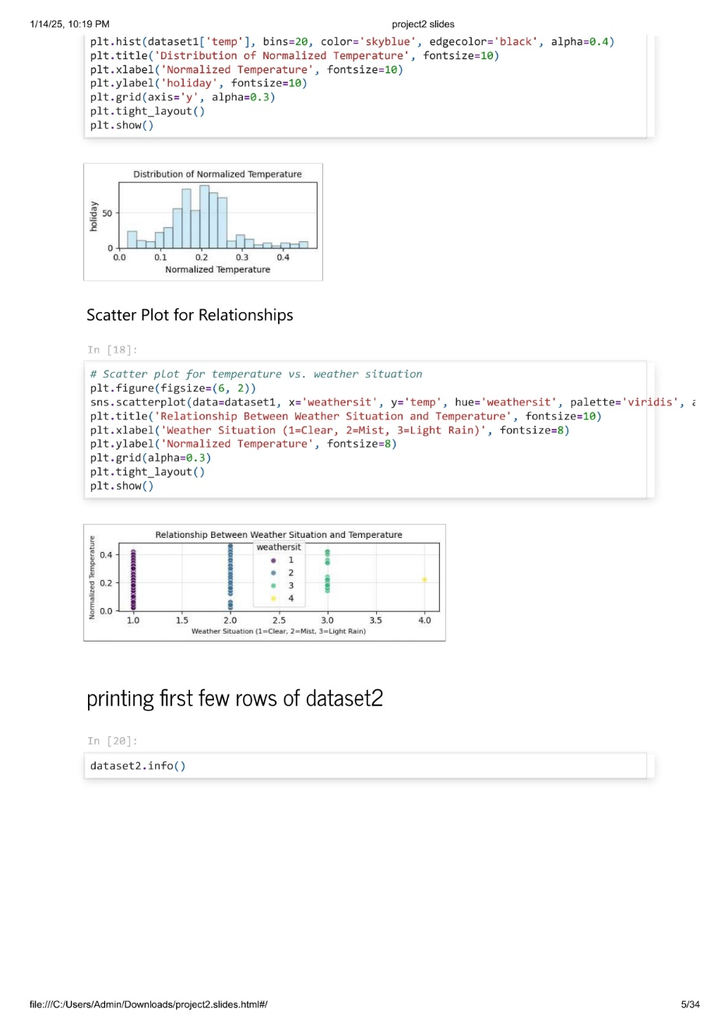
DATA VISULATIONS FOR DATASET1
Line Plot for Temporal Trends
Line plot represents the variations in the temperature on day to day
Distribution of temperature using a histogram
Scatter plot for temperature vs. weather situation

Slide 6
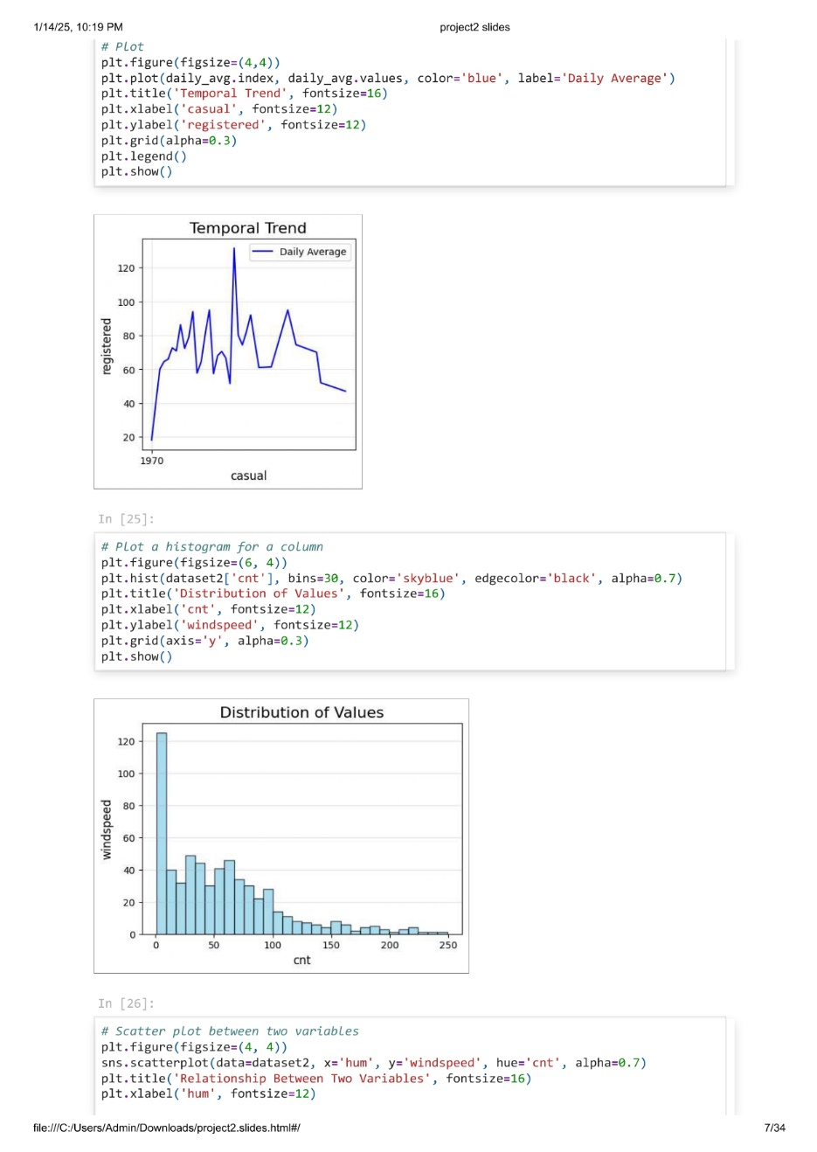

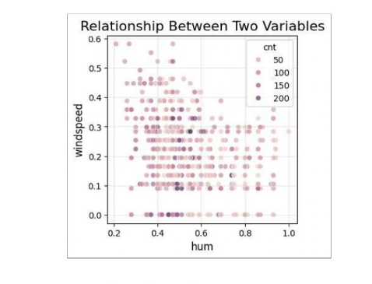
PRINTING FIRST FEW ROWS OF DATASET2 (Please refer slide no:4)
Line plot represents the variations in the registered of bikes on casual days.
Distribution of Wind speed using a histogram
Scatter plot between two variables of Wind speed and
Humidity

Slide 7
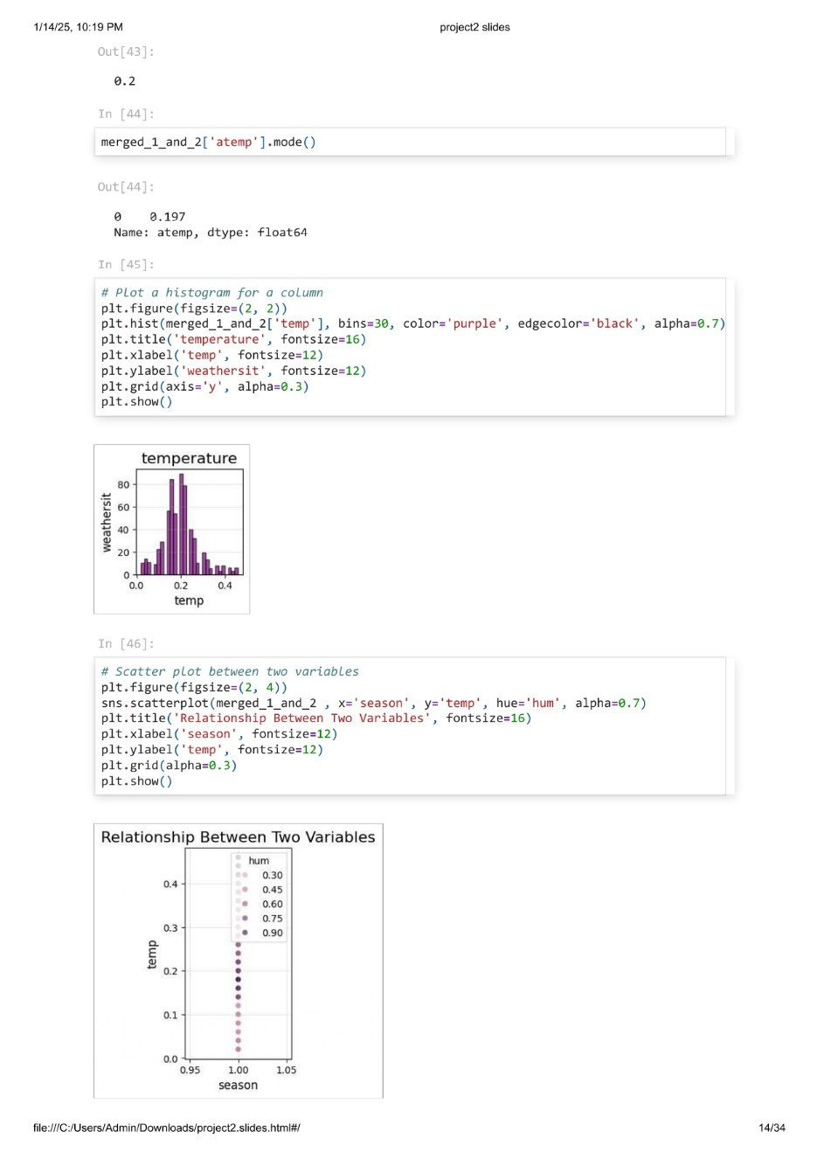
Merging of two datasets( dataset1 and dataset2) and then PRINTING FIRST
FEW ROWS of merged Dataset
Distribution of Weathersit and temperature using a histogram
Scatter plot between two variables of Temperature and
Season.

Slide 8
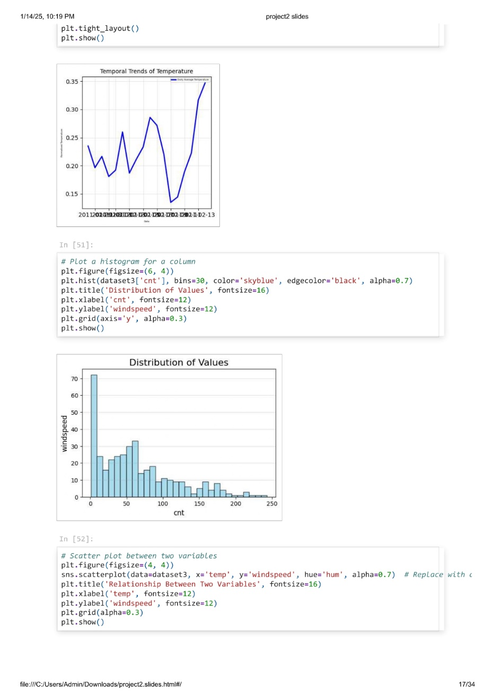
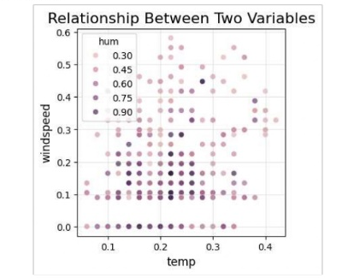
PRINTING FIRST FEW ROWS OF DATASET3(Please refer slide no:4)
Line plot represents the variations in the registered of bikes on casual days.
Distribution of Wind speed using a histogram
Scatter plot between two variables of Wind speed and Humidity

Slide 9
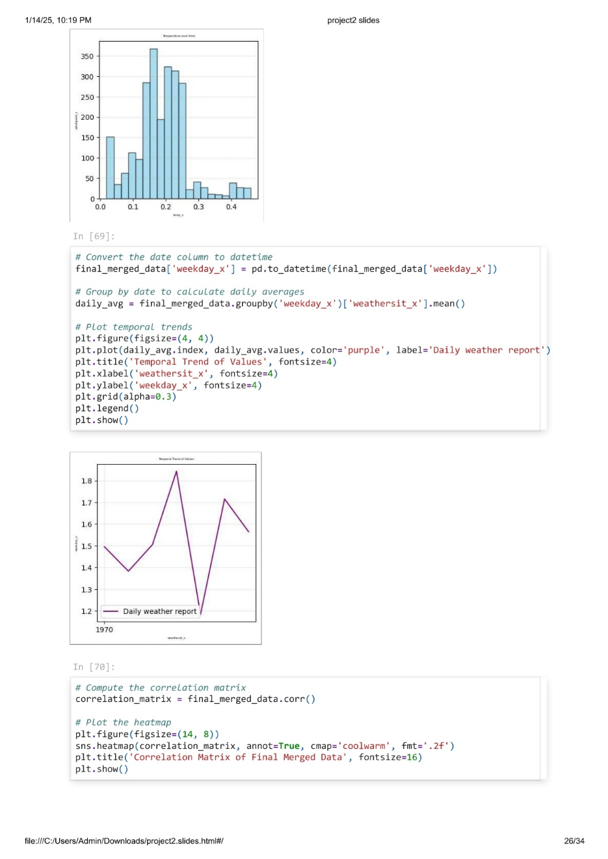
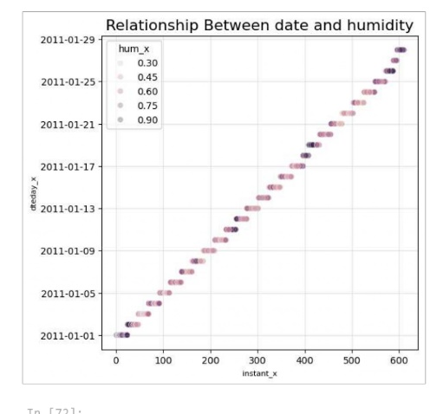
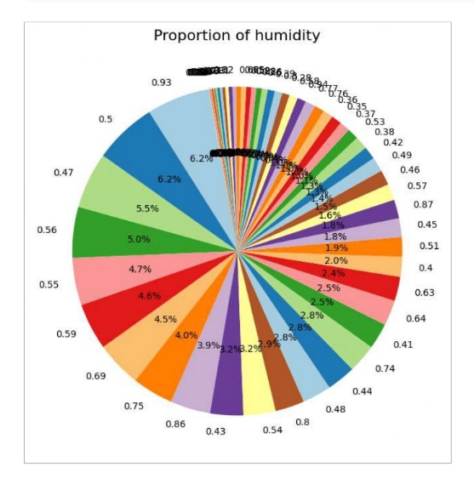
Distribution of Windspeed and temperature using a histogram
Line plot represents the variations in the weathersit on Weekdays.
Scatter plot between two variables of day and Humidity
Aggregate data for a categorical column
Proportion of humidity

Slide 10

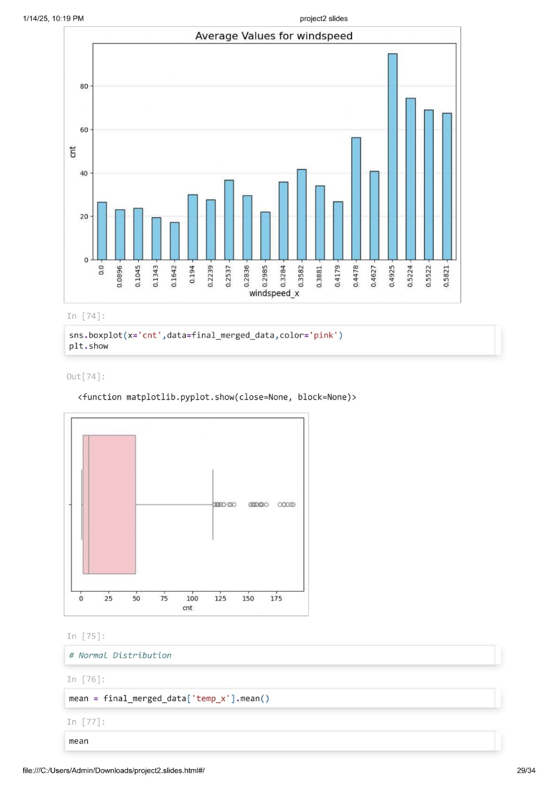
Correlation Matrix for All Numeric Variables
This helps identify which variables are most strongly related to temperature:
Finding the Outliers after merging
dataset3 and merged data
There are some outliers deducted from the final data

Slide 11
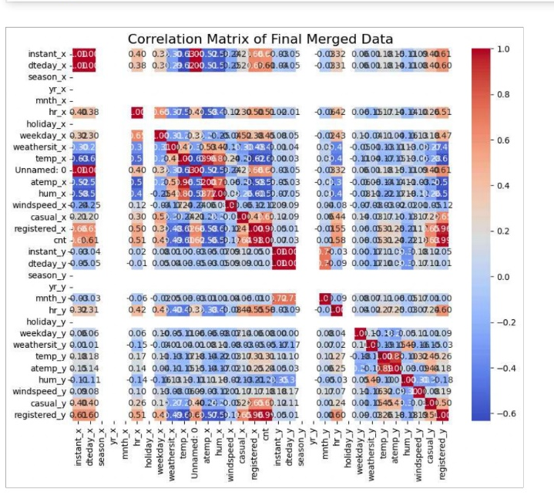
Correlation Matrix for All Numeric Variables
of final merged data
This helps identify which variables are most strongly related to temperature:

Slide 12
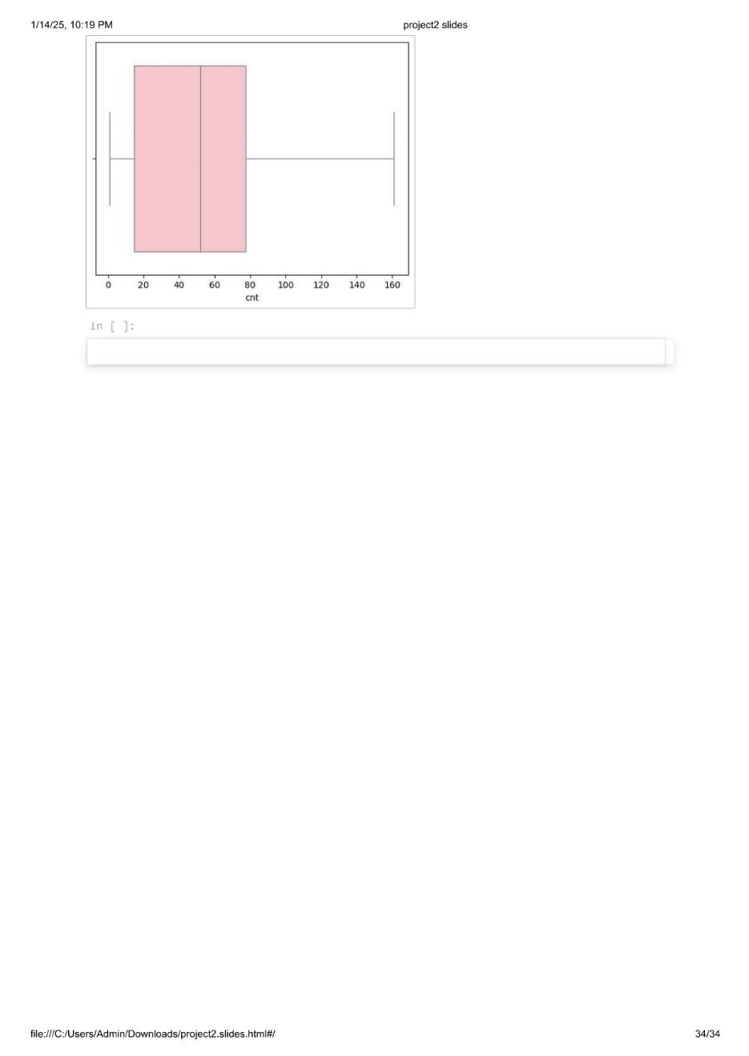
Correlation Matrix for All Numeric Variables
Handled outliers

Slide 13
Thank you

